Slide 1
Stratifying ROSMAP patients with archetype analysis
Notes:
A method for studying heterogeneity in multidimensional spaces, developed originally in the context of engineering and economics, and was recently adopted by Uri Alon and his lab from Weizmann Inst in Israel to study biological systems, especially gene expression data.

Slide 2
Complex systems need to perform multiple tasks
No system can be optimized for all tasks simultaneously, leading to trade-offs.
Problem: identifying types and the effective number of dimensions
Korem et al 2015
Notes:
The basic idea of archetype analysis is that complex systems need to perform multiple tasks and no system can be optimized for all tasks at the same time. That leads to trade-offs, or compromises, which manifest themselves as different types in the multidimensional space.
So if we think about eco-morphology: we have here herbivores that are optimized to eating plants and faunivores that eat only other animals. Every phenotype along this line represents a compromise between these two end members that is best suited to a specific combination of diets.
And if we think about gene expression, each type of cells here is specialized to perform a specific physiological task associated with a unique gene expression profile. But real cells need to perform more than one task so they end up lying somewhere in between, and we can characterize them based on how close they are to each archetype, which presumably reflects how well they can perform each of these tasks.
The basic problem here is, as always, to identify these types and determine the effective number of dimensions. This is usually approached with some factor analysis like PCA or k-means clustering etc. These methods approach the problem from a purely mathematical perspective of decomposing the variance in the system regardless of what’s underlying the variation. When we think about it from the system’s perspective, we’re rephrasing the problem as finding those underlying tasks, this presumably should give us more biologically-relevant features. To put it in the simplest terms, while methods like k-means clustering and PCA are focused on finding the averaged type, this method looks to identify the extremes in the data, the archetypes, and that in itself should potentially provide a clearer signal for what distinguishes those types.

Slide 3
Complex systems need to perform multiple tasks
No system can be optimized for all tasks at the same time, leading to trade-offs.
Solution: apply selection theory to find number and position of archetypes
The fitness function is a linear combination of the ability of a given phenotype v to perform each task
F(v) = f_{h}(p₁(v), p₂(v), …, p_{k}(v)) (Arnold 1983)
The performance of each task is weighted by how important it is for a particular niche
The Pareto front is the set of best compromises
Each point along the Pareto front is a niche
Phenotypes off the front are outperformed and eliminated
Pareto front
Sheftel et al. 2013
Notes:
But more importantly, phrasing it in terms of tasks and trade-offs allows us to apply selection theory and the fitness function, that are inherently all about optimizing trade-offs.
Briefly: because we assume that performance is a decreasing function of distance from the archetypes, the best compromises necessarily lie on a straight line in the case of two archetypes (triangle in the case of 3, etc) and therefore any phenotype that lies off the line is by definition underperforming and therefore eliminated.
In more details:
It starts by assuming that the fitness function is a linear combination of the ability of each phenotype to perform each task.
v is a phenotype – a unique combination of traits – p1 is the ability of that phenotype to perform task 1, and f tells us how much each task is weighted based on how important it is in any given niche, so for example the ability to break down cellulose will be weighted as zero for a carnivore but will be heavily weighted for a herbivore.
This results in what is called the Pareto front, which is the set of best compromises a straight line in the case of two archetypes - where each point along this front is a niche. Moving along this front leads to an improvement in some tasks on the expense of the others. Phenotypes that fall off this front are by definition outperformed by those on the front and therefore get eliminated by selection.

Slide 4
Assumptions:
For each task there is a single phenotype that maximizes performance for that task (the archetype)
Performance decays monotonically with distance from archetype
All performance functions decay with the same norm from their maxima
Predictions:
The Pareto Front of complex systems is a convex hull (polytope)
Archetypes are the vertices of the polytope
The effective dimensionality of the system is k – 1; where k is number of archetypes
No matter how many traits represent the system, naturally-selected phenotypes will fall on a polytope within a low-dimensional space based on the number of tasks
Sheftel et al 2013

Slide 5
Find number and position of archetypes of AD patients (ROSMAP cohort)
Extract “typical” gene expression profiles (== modules)
Compare with current (sub)modules
Map distance from archetypes onto WGS
Notes:
The workflow that I’ve been following here
Instead of the usual “two-step” solution of first generating modules and then cluster individuals, here we’re achieving these two goals simultaneously.

Slide 6
Model-AD pipeline
Milind et al. in review
Notes:
So this is the current Model-AD pipline using the “two-step” solution

Slide 7
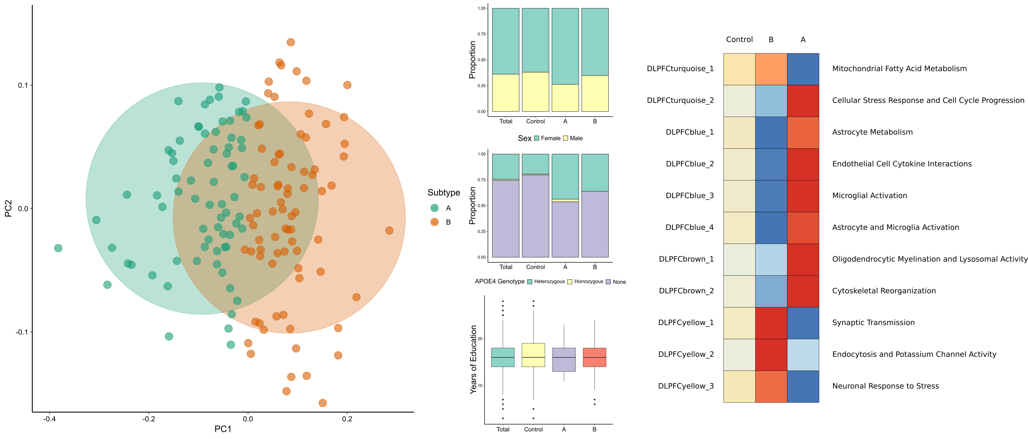
Notes:
A reminder - this is what Nikhil found in his study using this pipeline:
two main subtypes:
subtype A is mostly inflammation + various glial functions, while subtype B is mostly about signal transduction and neuronal function

Slide 8
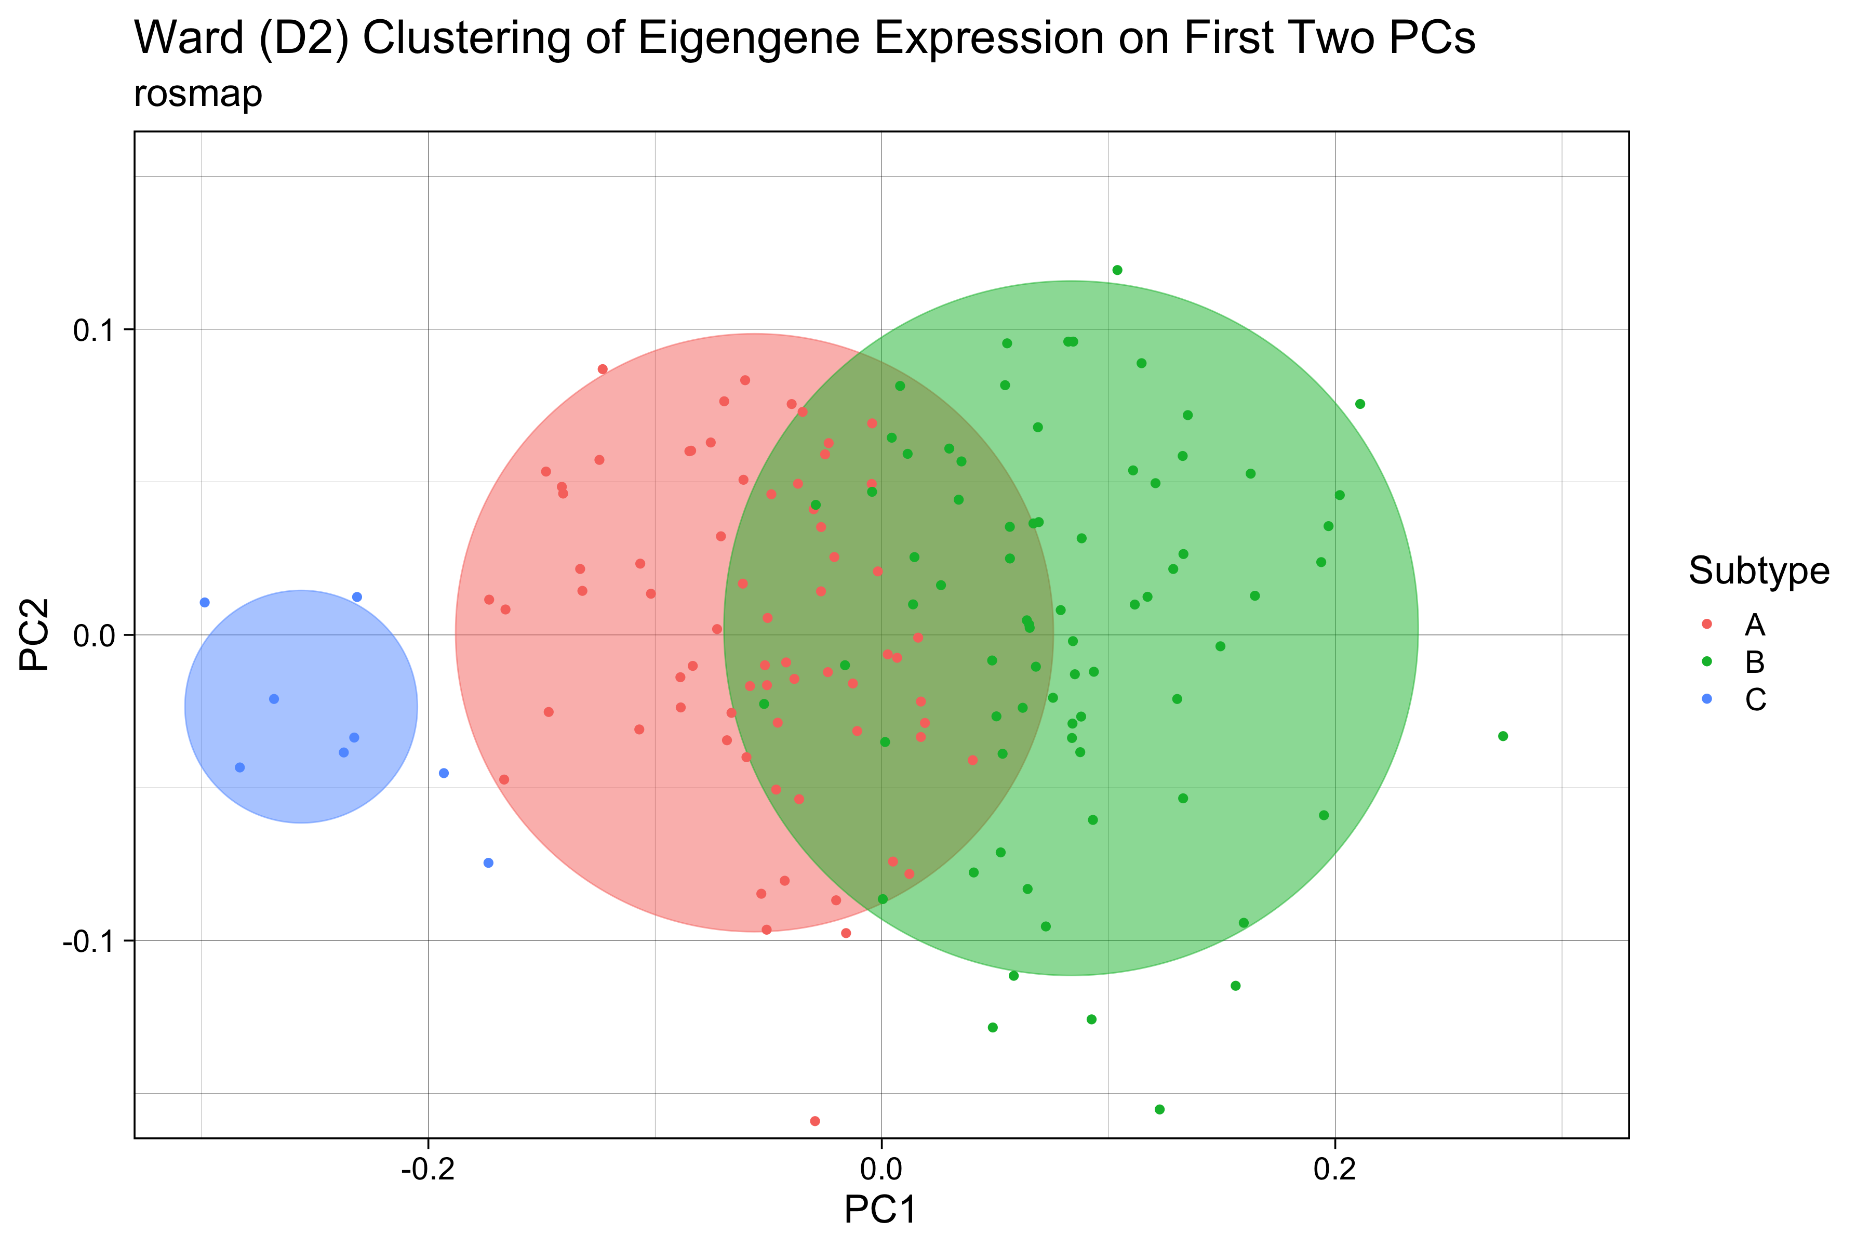
ROSMAP
(N=623)
Notes:
In the first round of Nikil’s study there were three subtypes found, 2 big ones and 1 small one, but the third one was too small, so it was dismissed. As I’ll show you in a second, using the archetype analysis we were able to recover that third subtype with a more even distribution of patients between the subtypes and a very distinct gene expression profile for each of them.

Slide 9
~ 20 non-random PC’s explain only 17%
~ 400 pc’s explain 80%
Notes:
Looking at the distribution of the data in general: the first 20 PC’s explain more variation than expected by chance using the broken-stick model as the null distribution.
But these 20 PC’s only explain a total of 17% of the variance so I repeated everything using 400 pc’s – 80% - of the variance and that gave essentially the same results, so we’ll stick with 20 PC’s from now on.

Slide 10
3 archetypes explain >50%
4th archetype adds < 5%
3 archetypes based on AD cases only
Notes:
The first step is to find the optimal number of archetypes by fitting polytopes with a different number of vertices and looking at how much variance they each explain.
For this step I used only patients diagnosed with AD – without control and MCI’s’ - in order to get the most relevant signal.
So a polytope with 2 archetypes – basically a straight line – explains less than 20% of the variance, but 3 archetypes – a triangle – already explain a little over 50%. Of course, the higher the number of archetypes the more variance explained, but it’s important to look also at how much more variance is explained with adding complexity. Adding a forth archetype only adds less than 5% to the explained variance. So looks like the optimal number of archetypes for this space is 3.
Other studies also found 3 subtypes for AD (rosmap cohort and others)
https://www.alzforum.org/news/conference-coverage/proteomics-uncovers-potential-markers-subtypes-alzheimers
The original papers and R package mostly uses Principal Convex Hull algorithm to fit the polytopes. But other methods are incorporated into Alon et al’s matlab package

Slide 11
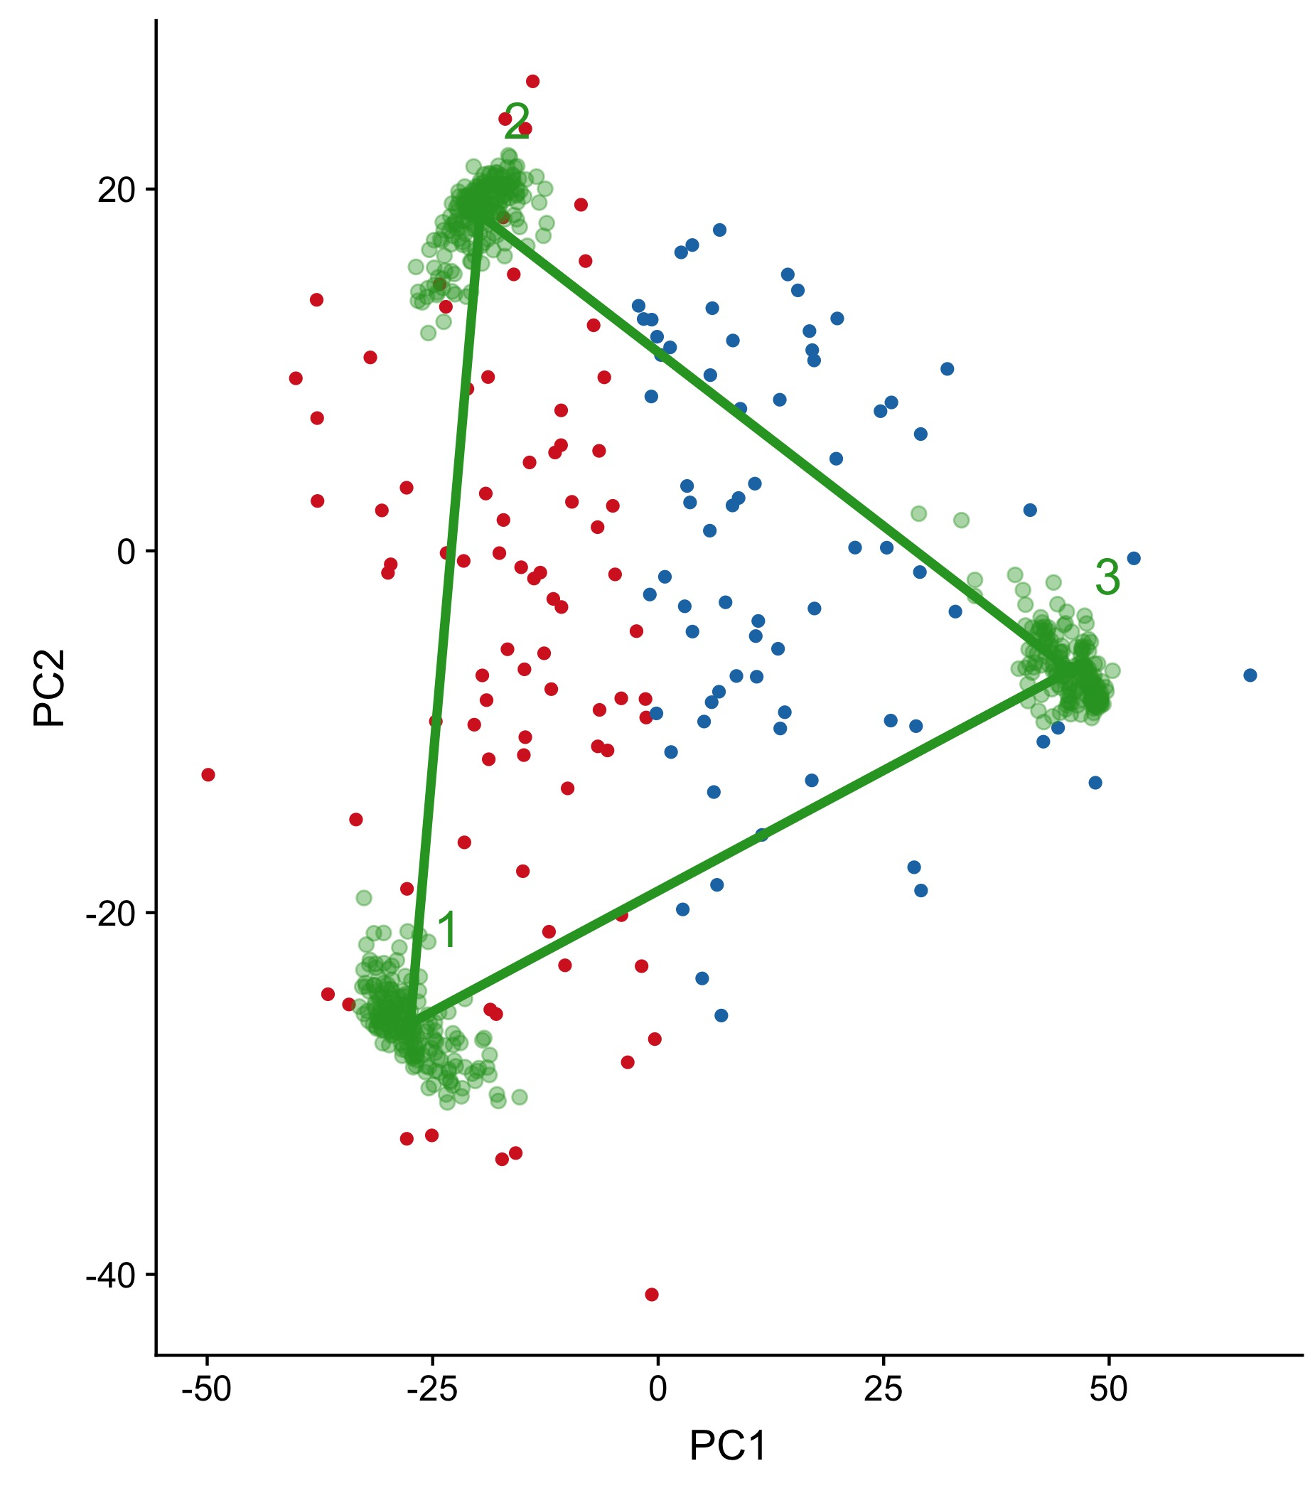
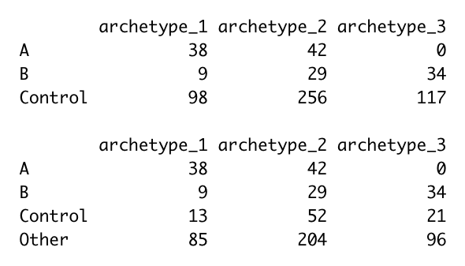
Position of archetypes in GE space relative to Nikil’s K-means subtypes
Archetype 3 is all subtype B
Archetype 1 is mostly subtype A
Archetype 2 is a mix
Control and Other are all over
B
A
bootstrap
Notes:
Comparing to Nikil’s subtypes
The green dots are archetype position in bootstrapped samples so give us an estimate of the potential error around archetype position

Slide 12
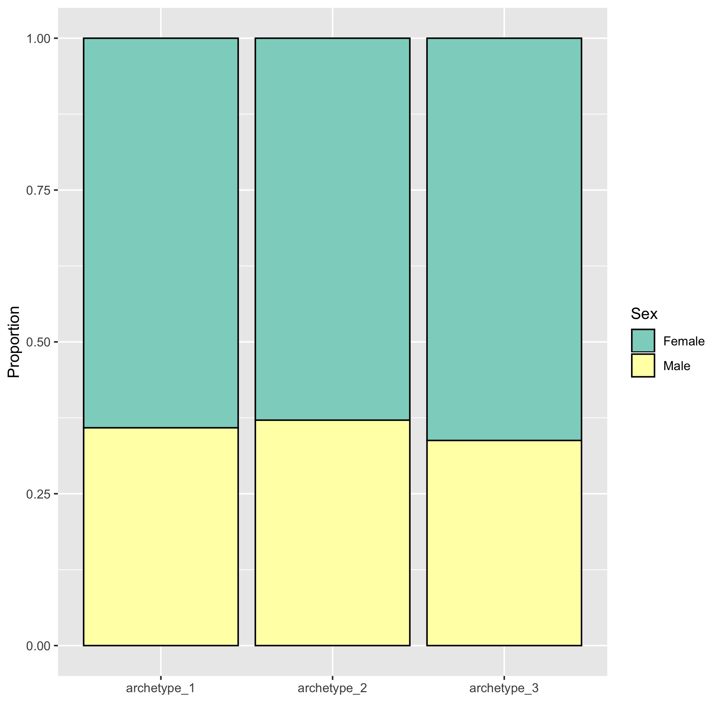
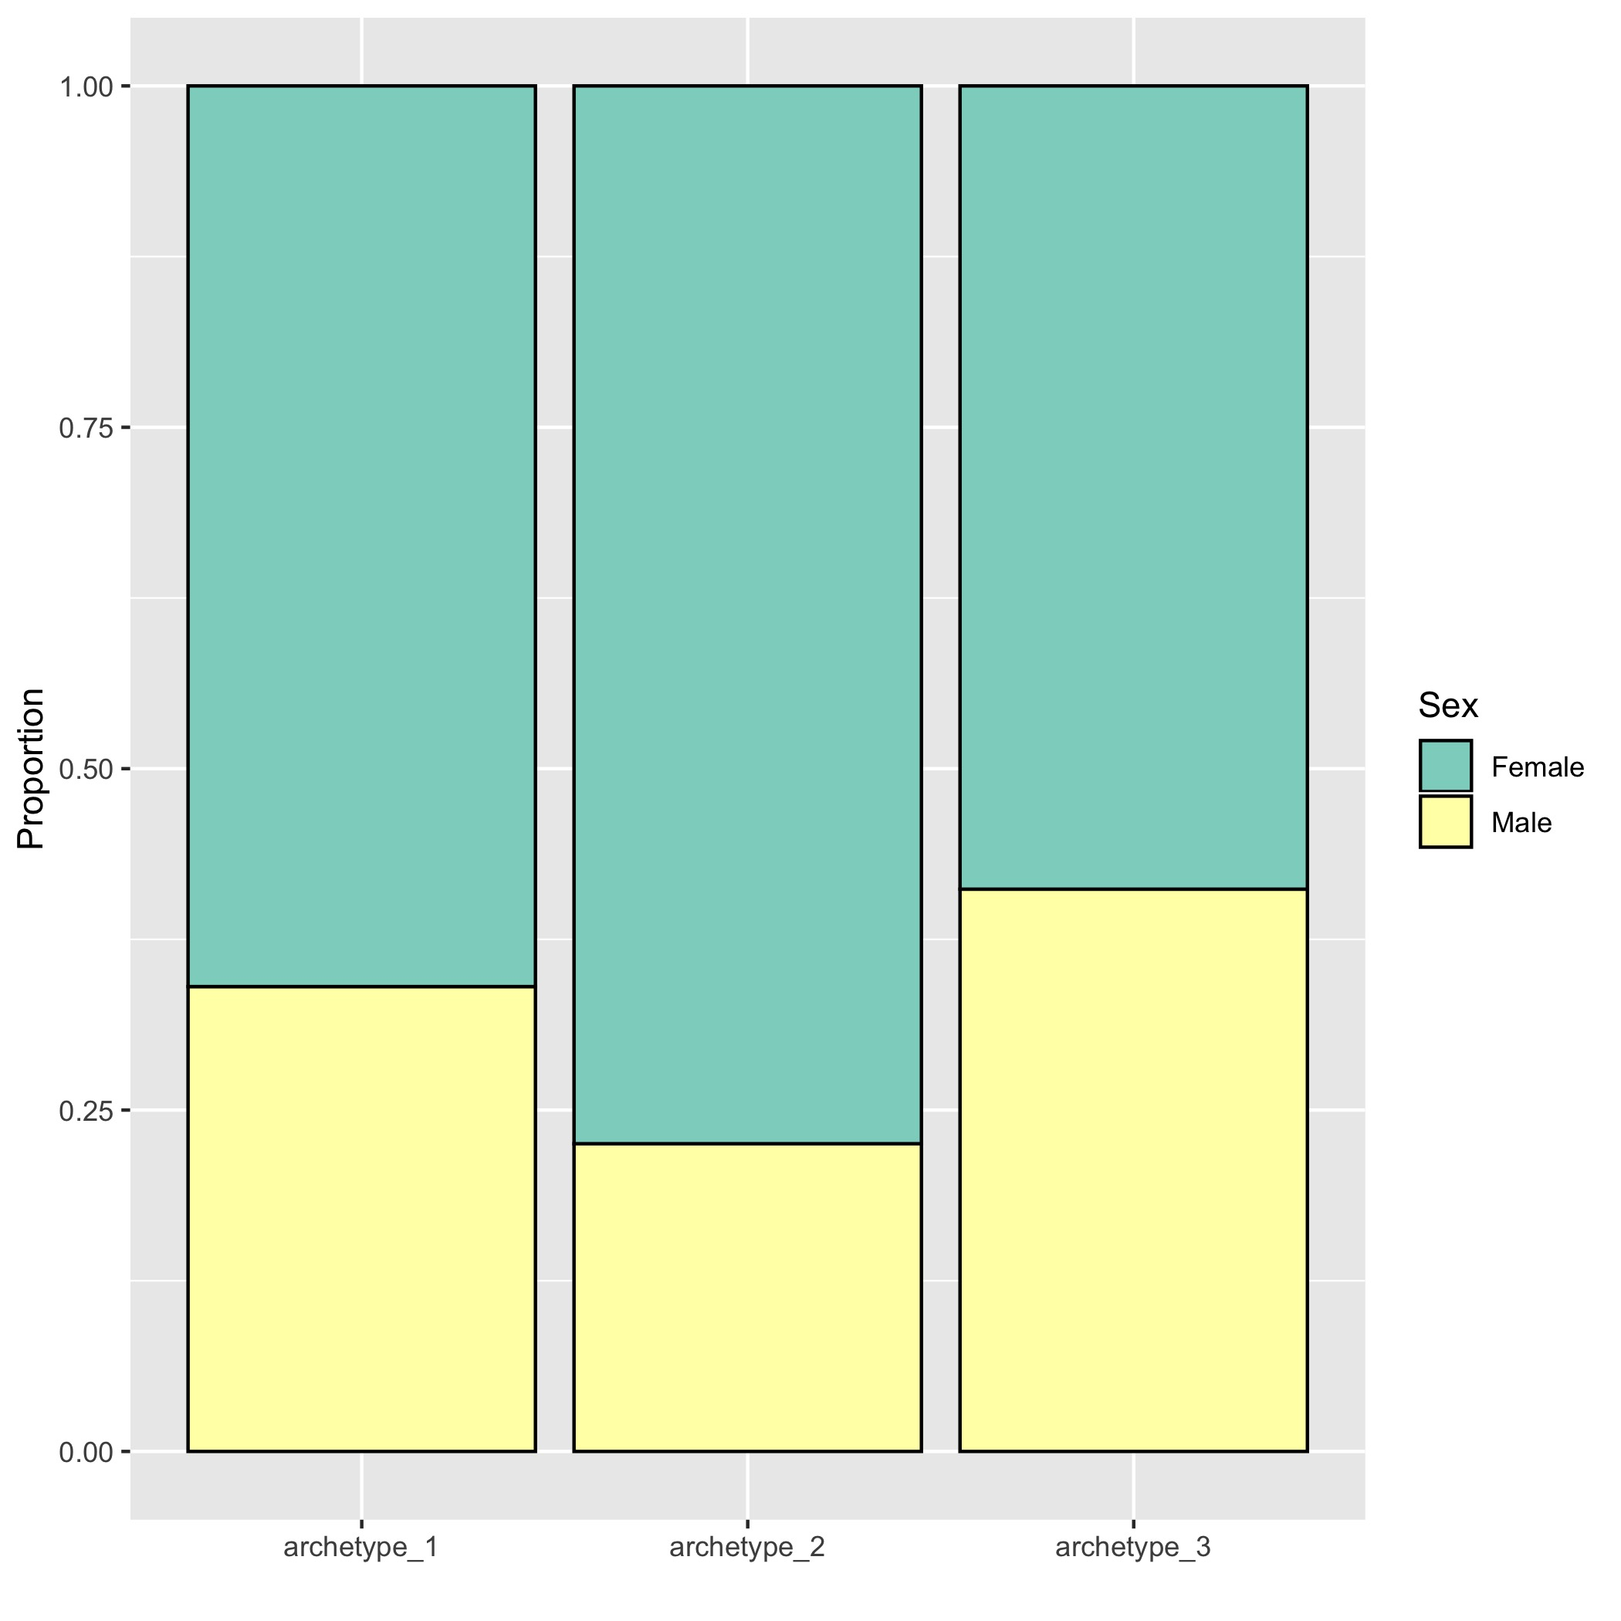
All samples (AD, MCI+others, control)
AD patients only
Notes:
Archetype 2 has relatively more females AD patients

Slide 13
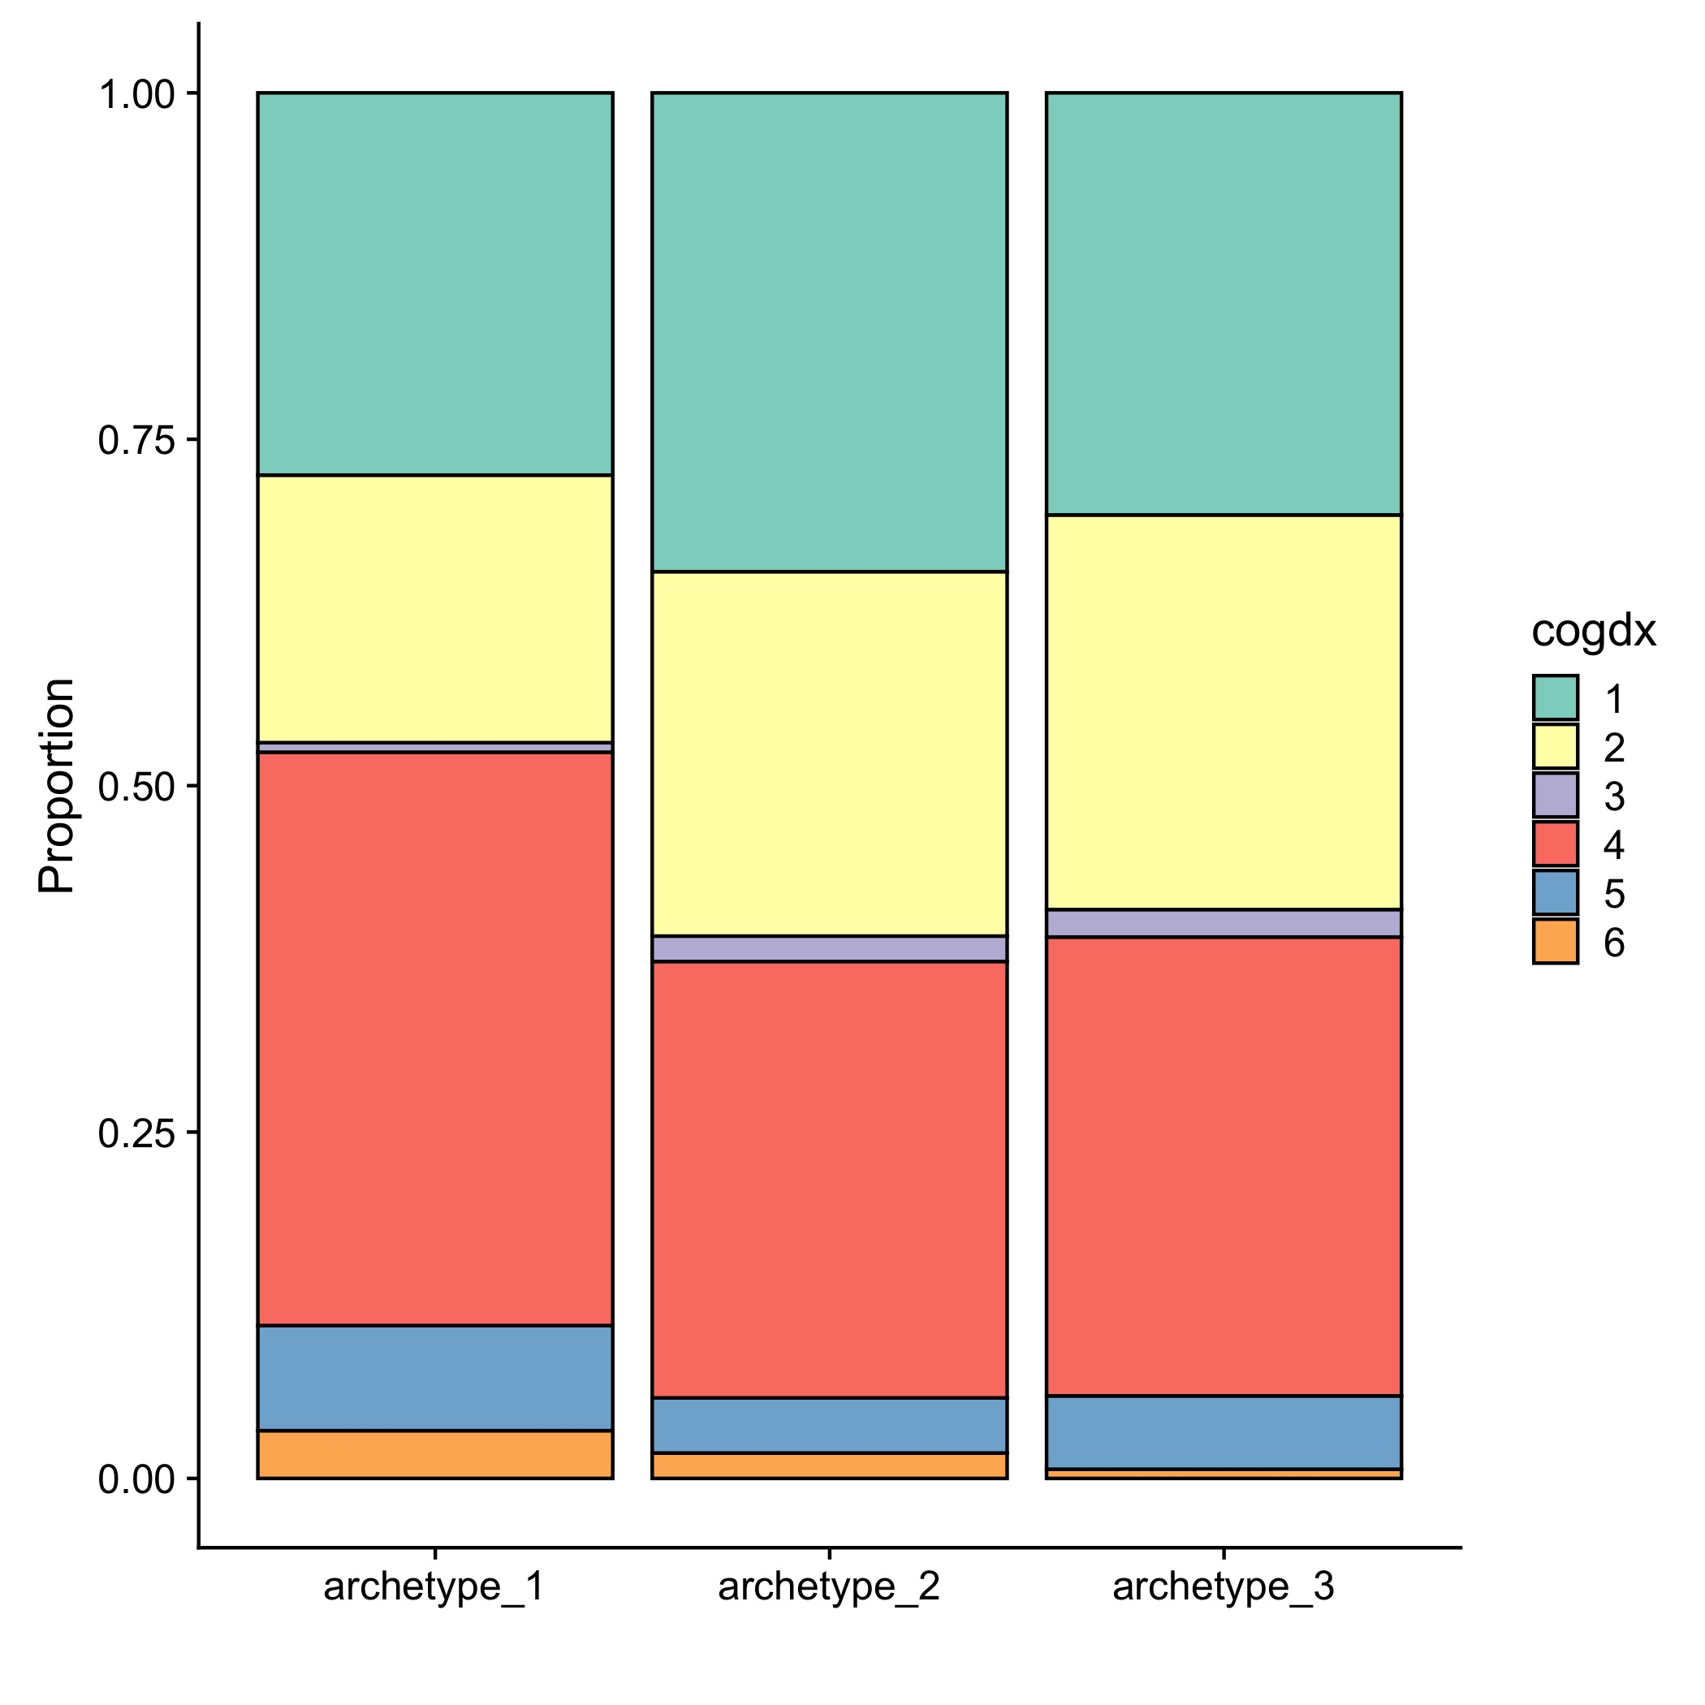
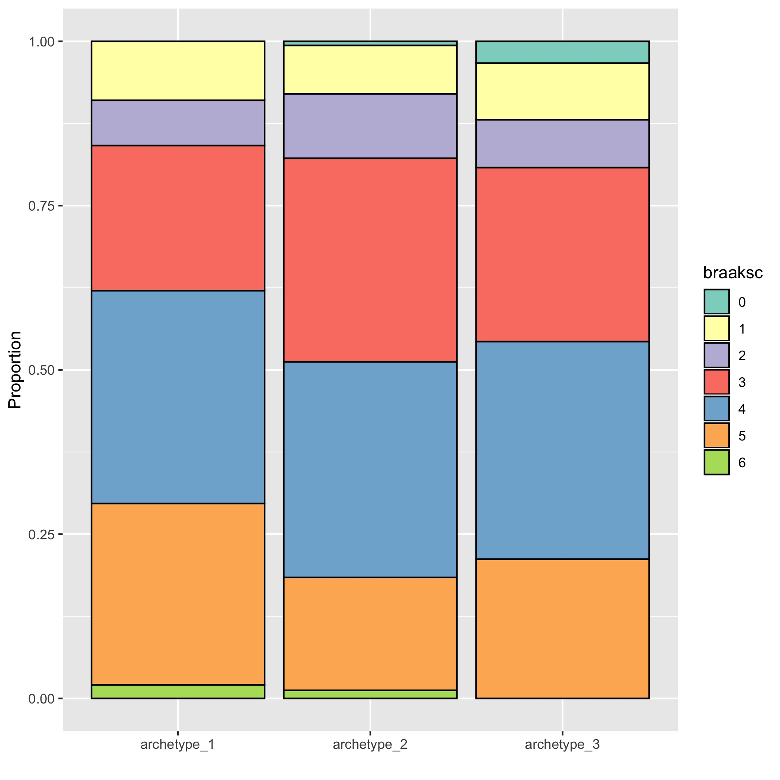
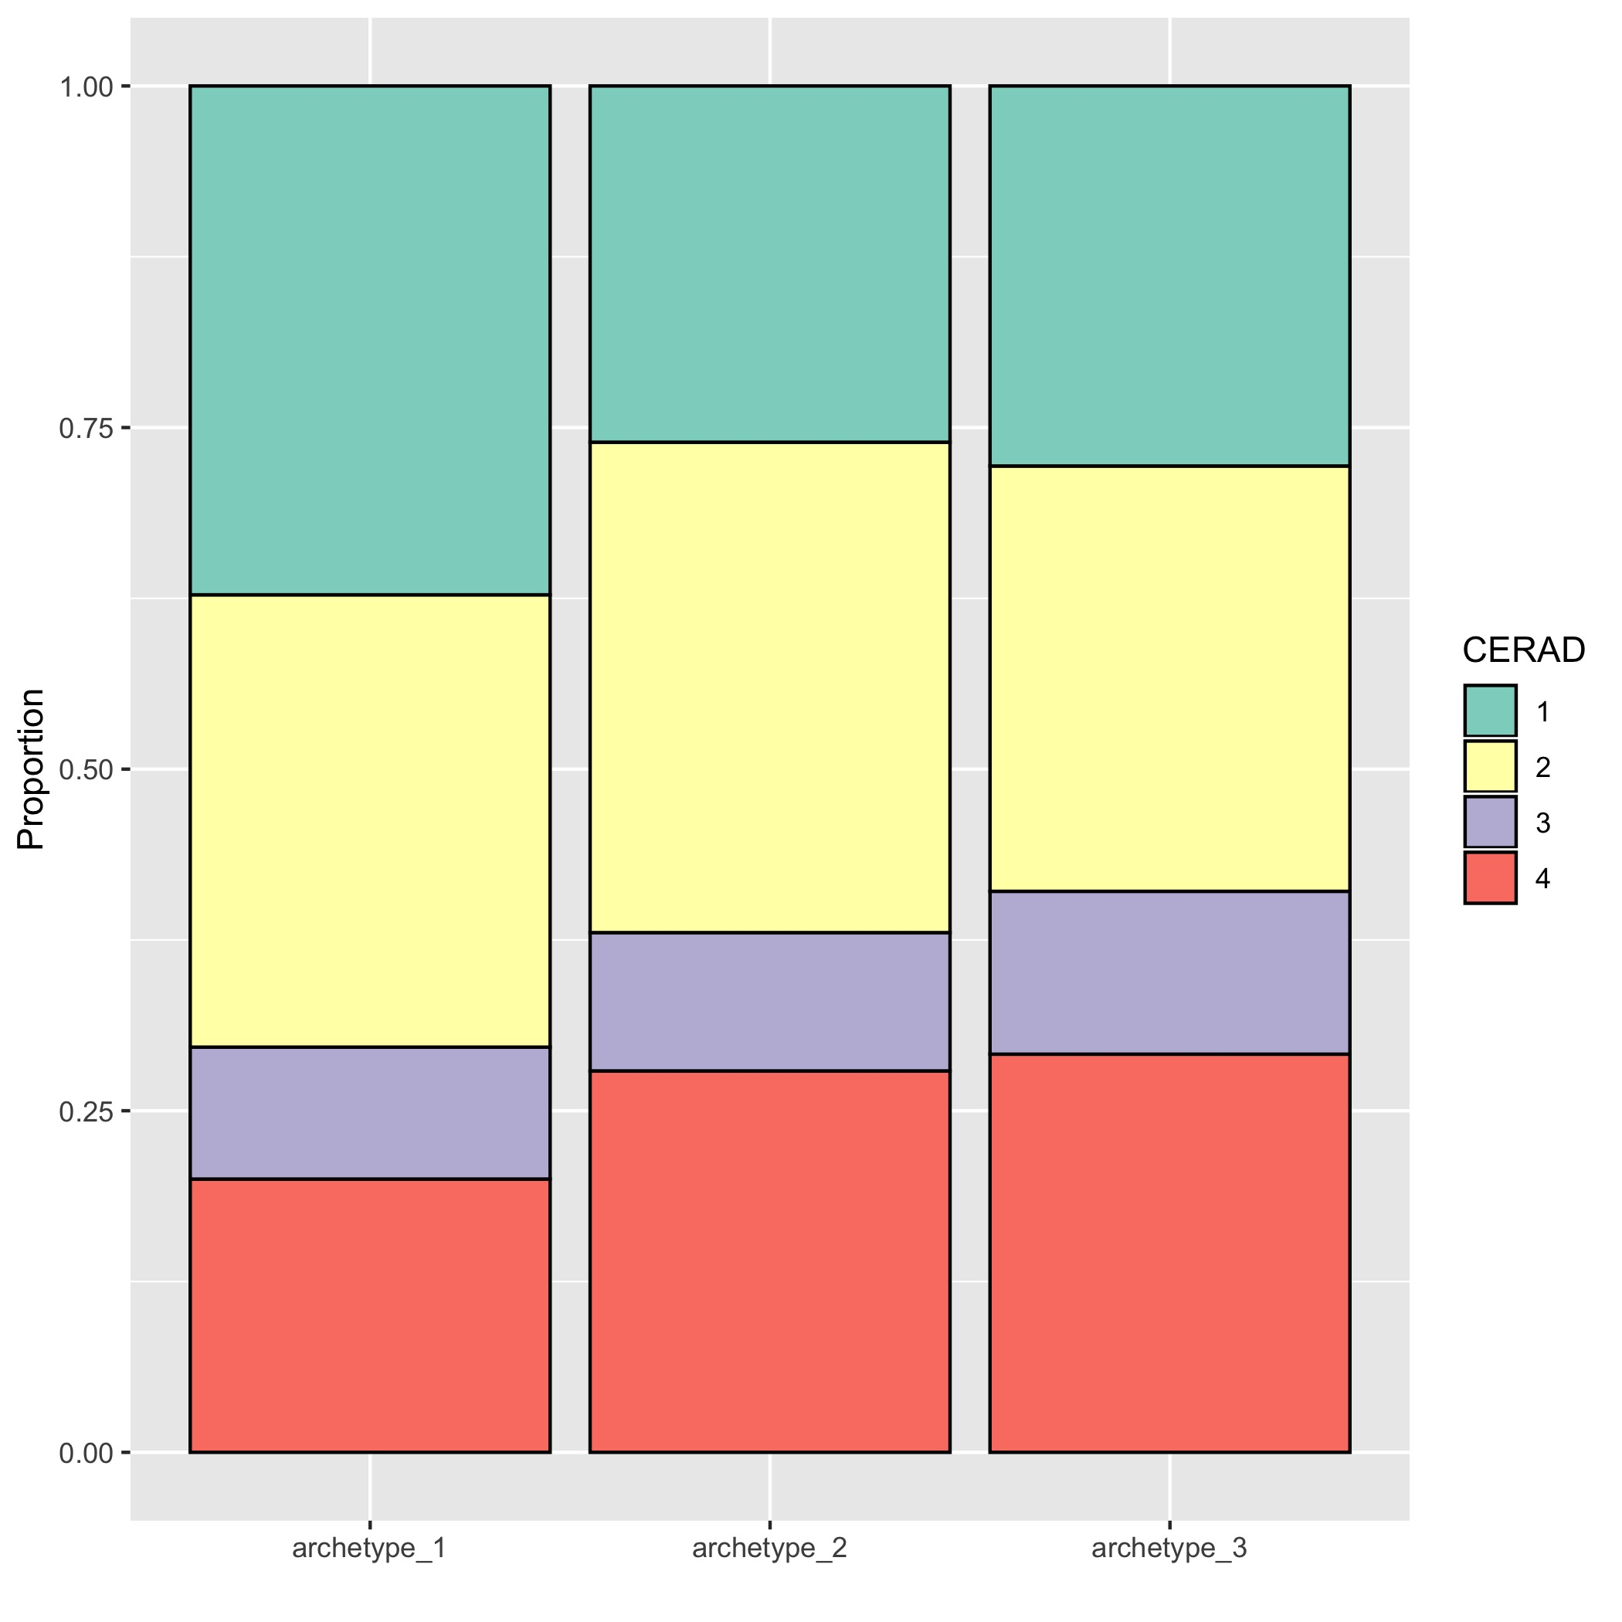
Diagnosis at time of death: Archetype 1 is slightly enriched for AD patients
Cognitive score
Braak
CERAD
------ Control -------
--------- AD -----------
--------- MCI -----------
--------- AD -----------
------ Control -------
--------- AD -----------

Slide 14
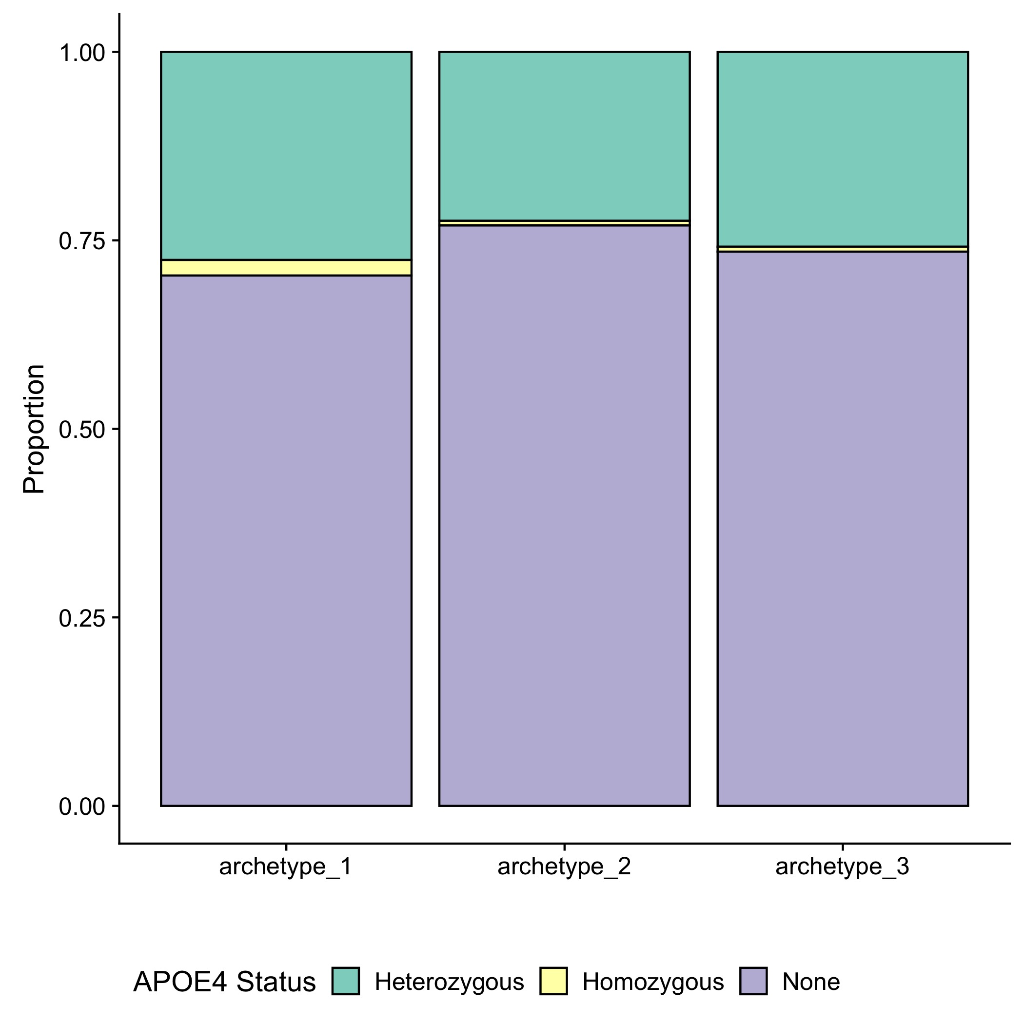
APOE4 status for all samples:
Archetype 1 includes slightly more heterozygotes and homozygotes
Notes:
All samples

Slide 15
Top genes breakdown:
Genes whose expression decreases significantly as a function of distance from an archetype
Archetype 1: 626 genes
Archetype 2: 551 genes
Archetype 3: 1538 genes
Overlap between archetype 1 and 2: 8 genes
Overlap between archetype 2 and 3: 1 gene
Overlap between archetype 3 and 1: None
Notes:
The next step is to find the genes whose expression is associated with each archetype, and to do that we fit a gamma distribution to the expression level of each gene as a decreasing function of distance from each archetype. So the idea is to find the genes whose expression level decreases rapidly and consistently in individuals that are further away from the archetype.
Out of the ~15000 genes in the original dataset, I found a total of ~2700 genes significantly associated with at least one of the archetypes, with only 8 genes overlap between arch_2 and 1, one gene between 2 and 3, and none between 1 and 3

Slide 16
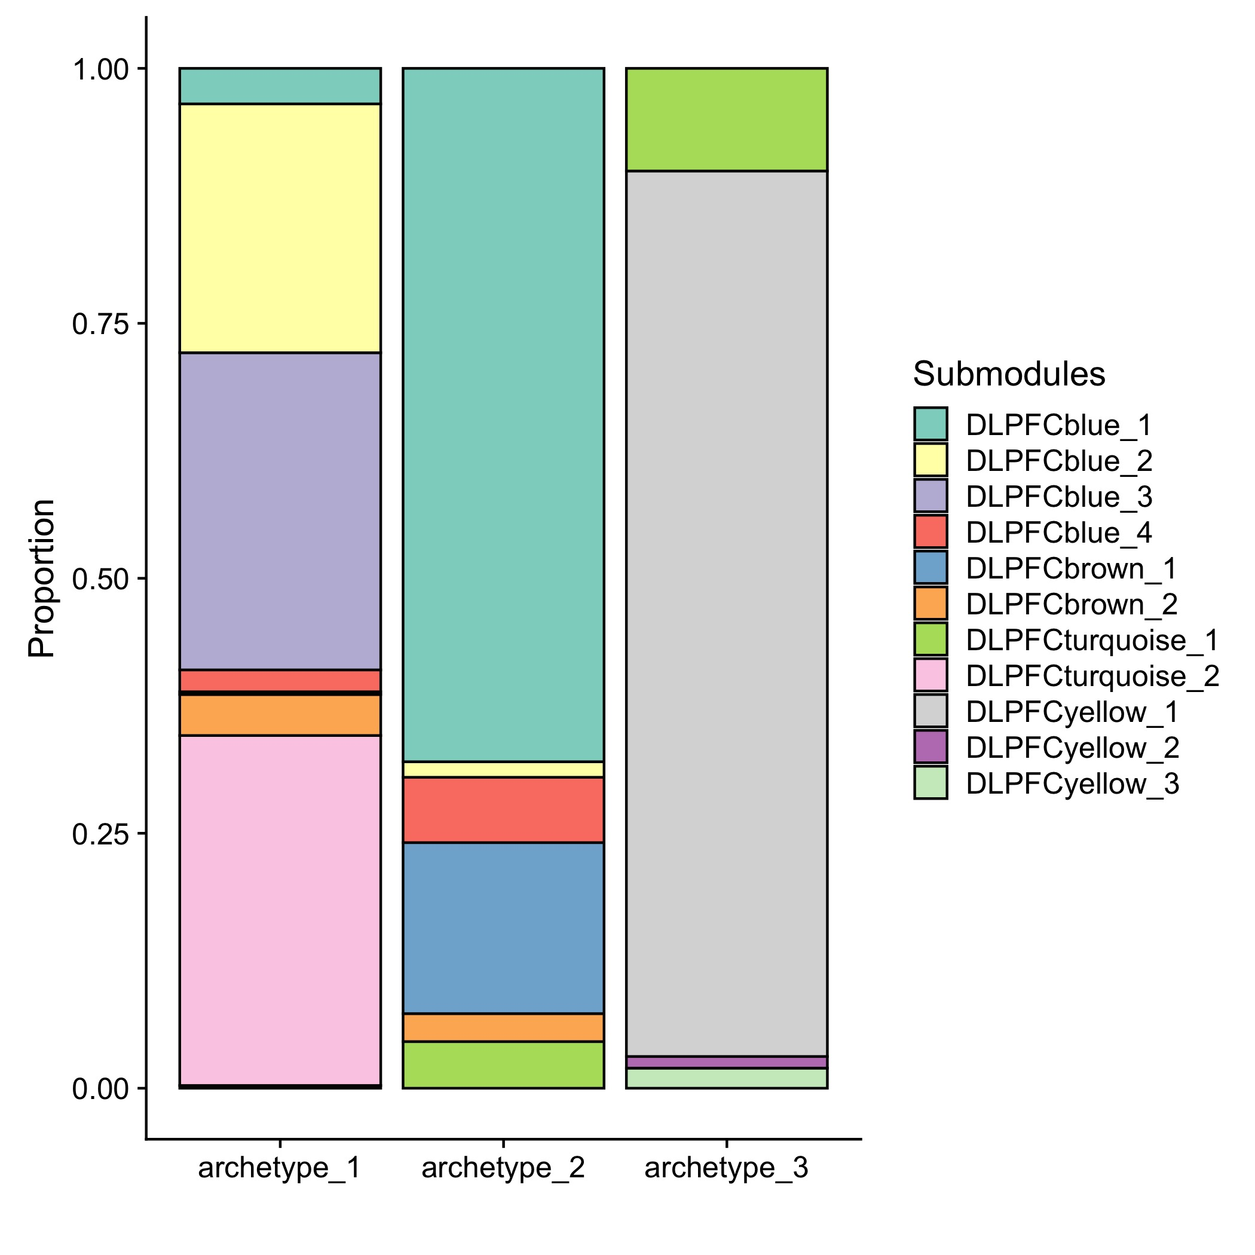
62% of the top genes are included in one of the submodules (80% in big modules)
Ng=626
Ng=551
Ng=1538
cytokine (immune) signaling
inflammatory
DLPFCyellow:neuronal
Synaptic signaling
microglial activation
immune response
protein folding
Stress response
astrocyte metabolism
oxydation-reduction
gliogenesis
oligodendrocytic myelination
A
A+B
B
Notes:
62% of the genes that I found are also in one of the submodules.
The submodule breakdown among the archetypes matches their overlap with the subtypes that Nikhil found.
Arch3 is all yellow, which is strongly enriched for neuronal signature (cluster C in Ben’s paper).
Arch1 includes all the blues and turquoise2, so basically inflammatory-related (B,E).
Arch2 is again more of a mix – mostly blue1 and brown1 – possibly related to basic functions of glial cells (B,D)

Slide 17
GO terms enrichment
Archetype 1
Archetype 2
Archetype 3
Notes:
An independent GO annotation gives a very clear functional signal for with each archetype
It’s especially interesting that archetype 2 is associated with metabolism and oxidative stress considering it also includes more female AD patients

Slide 18
Cell-specific marker genes
Astrocytes
Neurons
Endoth.
Microglia
Oligodendr.
Archetype 1
Archetype 2
Archetype 3
Notes:
A very clear association with cell type markers consistent with GO annotation

Slide 19
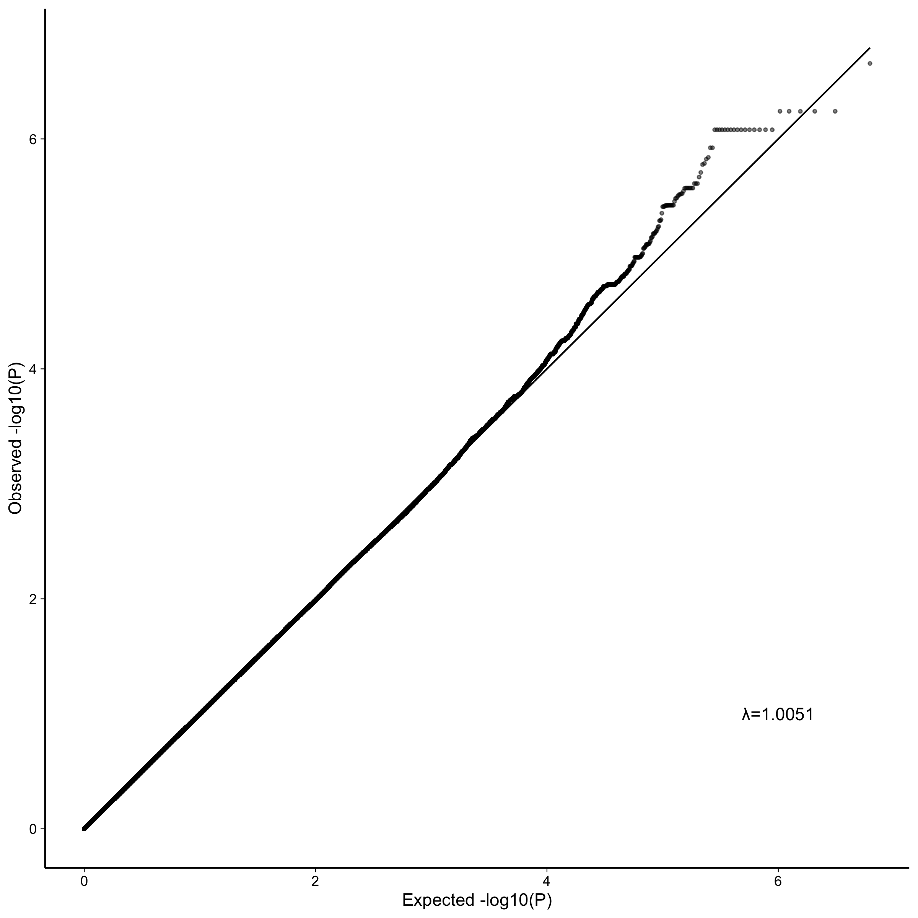
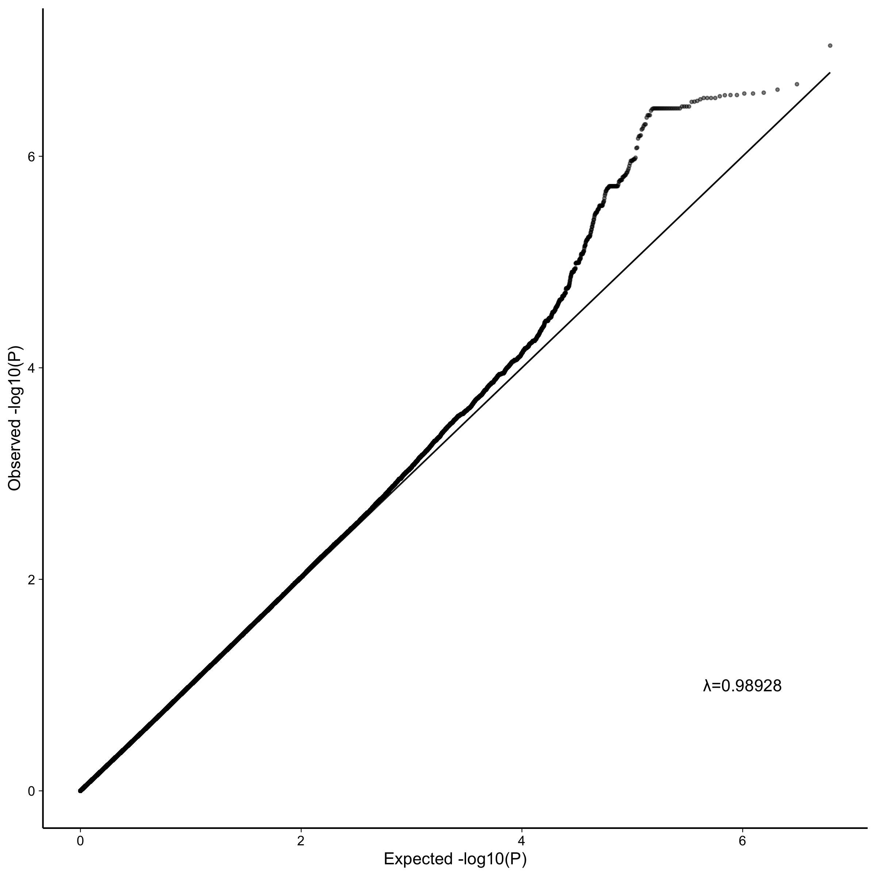
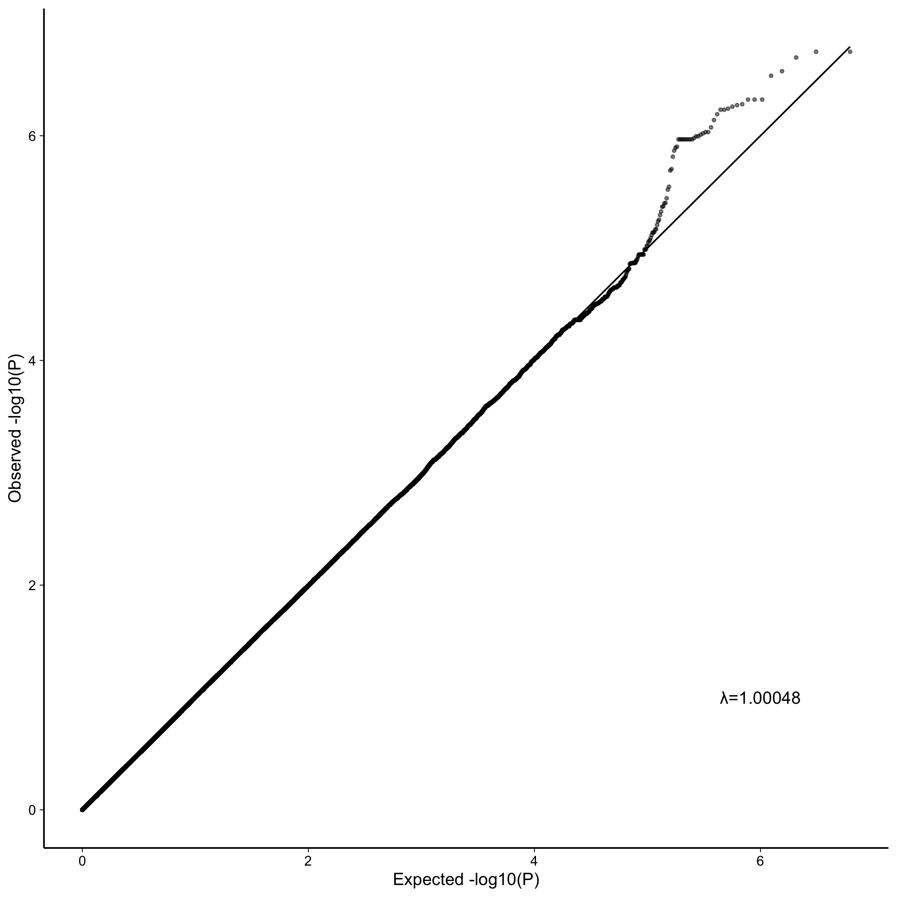
GWAS (EMMAX) of distance from each archetype for all samples
Archetype_1
Archetype_2
Archetype_3
Notes:
For the GWAS, I calculated the distance of each patient from each archetype, including the non-AD patients. That gives us three different phenotypes for the gwas.

Slide 20
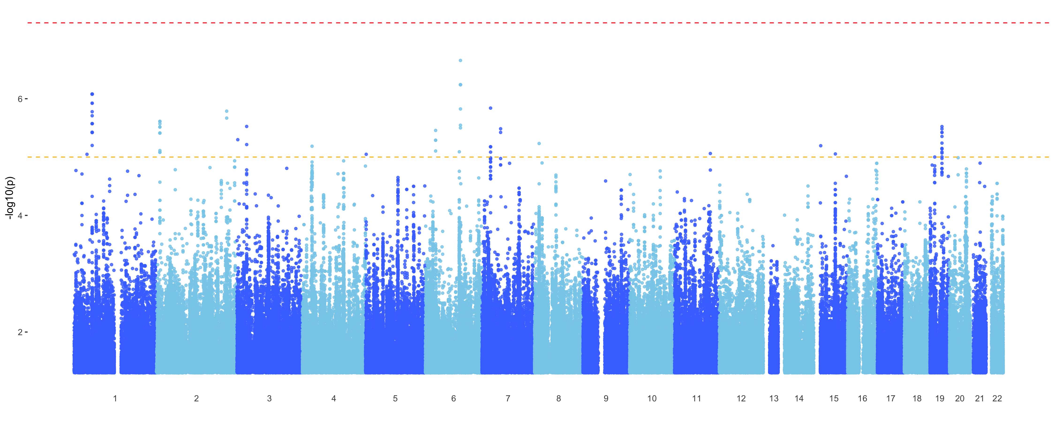
GWAS (EMMAX) of distance from each archetype for all samples
Archetype_1
Notes:
Nothing is significant at the 1^-8 level but plenty are suggestive

Slide 21
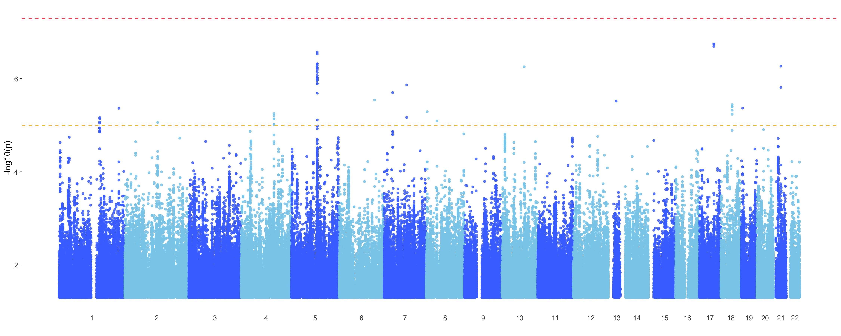
GWAS (EMMAX) of distance from each archetype for all samples
Archetype_2

Slide 22
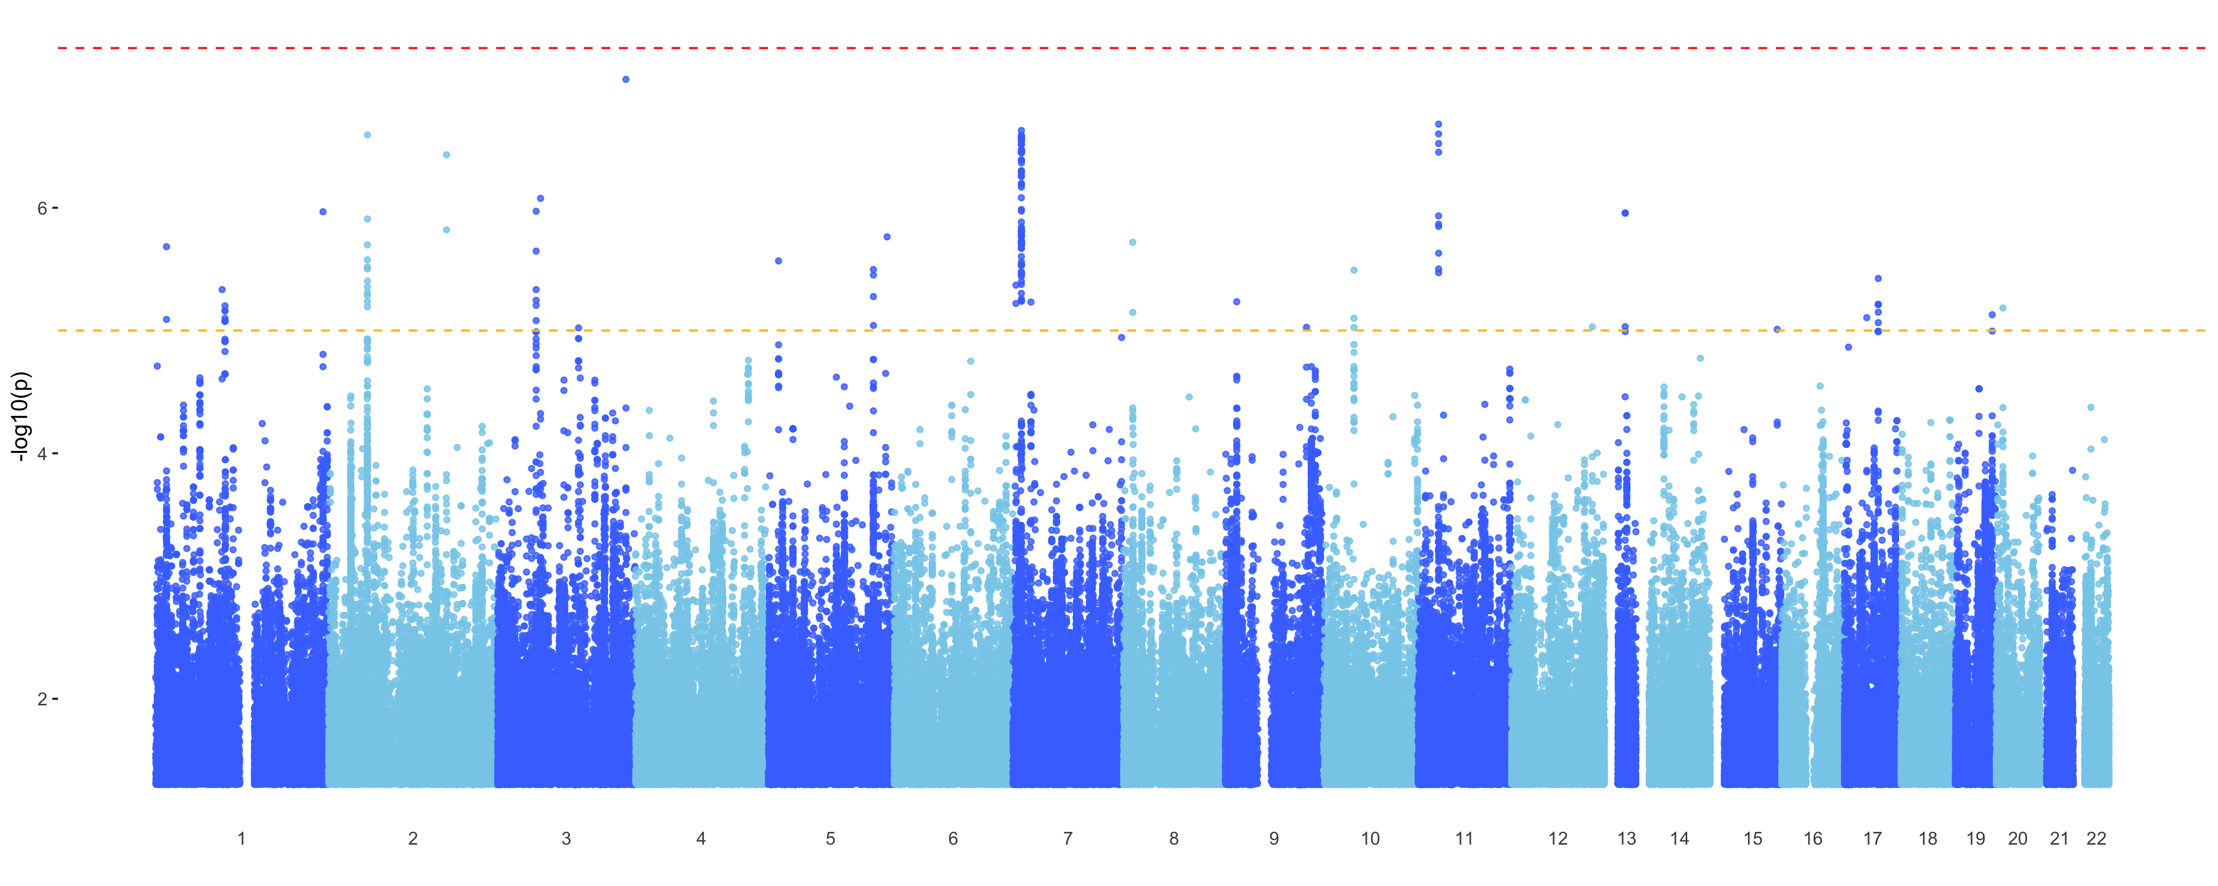
GWAS (EMMAX) of distance from each archetype for all samples
Archetype_3

Slide 23
Overlap of mapped genes between different phenotypes
C2orf48: ncRNA
SSBP3: transcription factor; collagen(?)
RGMB: cell adhesion/development
ANK1: cell motility/activation/proliferation
SLC14A2: cell adhesion; glucose/urea TM-transport
CSMD1: brain (cerebellum, hippocampus); glucose homeostasis, startle response
KCNA4: Potassium channels
RGS7: G-protein; K channels, signal transduction,
TMEM106B: transmembrane; interacts with apoe
BNC2: transcription factor; skin pigmentation, scoliosis
DLC1: cytoskeletal reorganization; tumor suppressor
Notes:
I took all the suggestive snps and ran them through FUMA to map them to genes, and then, following Nikhil’s example, I generated a network from these genes to see the structure of overlap between the different phenotypes.
So here I combine the mapped genes from my archetype analysis with those from Nikil’s analysis for the subtypes as well as clinical phenotypes (in red)
Looking at the architecture without submodules first:
In accord with what we found based on the gene expression alone:
Subtype A overlaps with archetypes 1 and 2, while subtype B overlaps with archetype 3.
Archetypes don’t overlap directly among themselves - and same for the subtypes (which we already knew from Nikhil’s work).
Clinical phenotypes don’t overlap much with the GE phenotypes. But, archetype 2 has one gene in common with clinical diagnosis and archetype 3 has one gene in common with cerad score, and that overlap isn't there when mapping based on subtypes
So you could say that we're breaking down subtype A into two separate genetic underpinnings.
The two genes shared between subtype A and archetype 1 are somewhat obscure and not clear how they relate to AD
But the three genes shared between subtype A and archetype 2 all related to cellular functions and glucose transport which is somewhat in accord with its annotation as related to gliogenesis and metabolism
The gene shared between archetype 2 and clinical diagnosis is also related to glucose metabolism and brain function
The three genes shared between subtype B and archetype 3 are all highly expressed in the brain and involved in potassium channels and neuronal signal transduction, again in accord with this being the neuronal archetype.
TMEM106B is well known to pop up in LOAD GWAS and interact with APOE

Slide 24
Overlap of mapped genes between different phenotypes
Notes:
Adding submodules to the picture:
For clarity I removed the genes that are not shared with at least one of the other phenotypes.
As Nikhil already found in his work, the submodules are all over the place, overlapping with archetypes and subtypes that are otherwise unassociated, but not much with clinical phenotypes.
Yellow_1 overlaps a lot with archetype_3, which is in accord with the gene expression data. same for brown_1 and yellow_2 overlapping with archetype 2, but otherwise it's not really in accord with the gene expression profiles.
Interestingly, archetype 3 overlaps with the submodules more than subtype B even though subtype B was more directly derived from the submodules. Particularly, it reveals 3 new genes that are joined between archetype 3 and two or more submodules:
CERS6: phospholipid activity; neuronal TM signal transduction; PD
PNPT1: oxidative phosphorylation; mtRNA metabolism
PTPRG: protein dephosphorylation; TM signal transduction; neuronal development; cellular processes (PTPN5)
https://www.ncbi.nlm.nih.gov/pubmed/28527217
In addition, KCNA4 and TMEM106B are even more of a hub when the submodules are included.
CNTNAP5: neurexin family; neuronal cell adhesion and intercellular communication; epidermal growth factor; in accord with the other genes associated with archetype_2

Slide 25
Conclusions:
Archetype analysis allowed stratifying patients into three classes instead of two
While archetype 1 and 3 largely correspond to subtype A and B, respectively, archetype 2 is more mixed, including more ”other” (MCI) cases
A clearer distinction between archetypes and their annotation
Non-overlapping GE modules
Archetype 1: inflammation
Archetype 2: metabolism, cellular functions, oxidative stress (and more female AD)
Archetype 3: Neuronal function
Archetypes overlap with clinical phenotypes in their mapped genes (slightly) more than subtypes do
Archetype 3 overlaps with the submodules more than subtype B does
New genes to consider for the mice models?

Slide 26
References for applying archetype analysis to biological systems:
Hart, Y., Sheftel, H., Hausser, J., Szekely, P., Ben-Moshe, N. B., Korem, Y., … Alon, U. (2015). Inferring biological tasks using Pareto analysis of high-dimensional data. Nature Methods, 12(3), 233–235. https://doi.org/10.1038/nmeth.3254
Shoval, O., Sheftel, H., Shinar, G., Hart, Y., Ramote, O., Mayo, A., … Alon, U. (2012). Evolutionary Trade-Offs, Pareto Optimality, and the Geometry of Phenotype Space. Science, 336(6085), 1157 LP-1160. https://doi.org/10.1126/science.1217405
Korem, Y., Szekely, P., Hart, Y., Sheftel, H., Hausser, J., Mayo, A., … Alon, U. (2015). Geometry of the Gene Expression Space of Individual Cells. PLOS Computational Biology, 11(7), e1004224. https://doi.org/10.1371/journal.pcbi.1004224
Sheftel, H., Shoval, O., Mayo, A., & Alon, U. (2013). The geometry of the Pareto front in biological phenotype space. Ecology and Evolution, 3(6), 1471–1483. https://doi.org/10.1002/ece3.528

Slide 27
Notes:
Relaxing the assumption that a task is represented by a point rather than a region

Slide 28
Example: Single-cell gene expression data from human colon crypt cells
K = 4
D = K-1 = 3
Four vertices (Tetrahedron) explains 45% of the variance
Three PC’s explain 95% of the variance
Distributed kinda sort of like a tetrahedron
Korem et al 2015
Notes:
Looking at an example from their paper:
They analyze single-cell expression data from human colon crypt cells, and calculated the variance explained by the best-fit polytopes that encompass the data, starting with 2 archetypes, basically a line, and adding one vertex at a time. They find that the first bend in this curve yields 4 vertices, so a tetrahedron, explaining 45% of the variance. The classical PCA scree plot also shows 4 significant dimensions, where the first 3 explain 95% of the variance and the forth doesn’t really add much, so effectively 3 dimensions as predicted. And the data distribution in these 3 dimensions actually does look a bit like a tetrahedron.

Slide 29
Example: Single-cell gene expression data from human colon crypt cells
Each of the archetypes shows high expression of a set of markers typical of a specific crypt cell type
Korem et al 2015
Notes:
Looking at the expression profiles of points closest to each of the vertices we can infer the biological function of each archetype, and we can see here that it does match the expectation based on the cell types that we know exist in this example based on specific markers

Slide 30
Main attributes and advantages:
The orientation of the archetypes does not generally align with the PC’s, implying that the biological meaning of the archetypes is distinct from that carried by the PCA components.
Less sensitive to sampling error
Avoids the problem of determining cluster boundaries that are usually fuzzy
Reducing dimensionality beforehand is not necessary
Small sets of genes (traits) with small but biologically-relevant effect will be lost
Notes:
They analyzed several datasets from different biological contexts in a series of papers.
To summarize the important points that they found:
First and foremost: The orientation of the archetypes does not generally align with the first PC, implying that the biological meaning of the archetypes is distinct from that carried by the PCA components.
Hyperspectral unmixing algorithms for determining the position of the archetypes. And the elbow in the explained variance function to identify the number of dimensions. 5 different algorithms are implemented in their Matlab package.
In addition:
Less sensitive to sampling error
Avoids the problem of determining cluster boundaries that are usually fuzzy
Reducing dimensionality with PCA beforehand is not necessary
But:
Small sets of genes (traits) with small but biologically-relevant effect will be lost (a follow-up paper tries to work around it by giving different weights to different genes based on a priori knowledge of their relevance)
(Also, can calculate the clumpiness of the data by the ratio of local density of the data to that expected for a randomized dataset [Korem et al])

